Slide 1
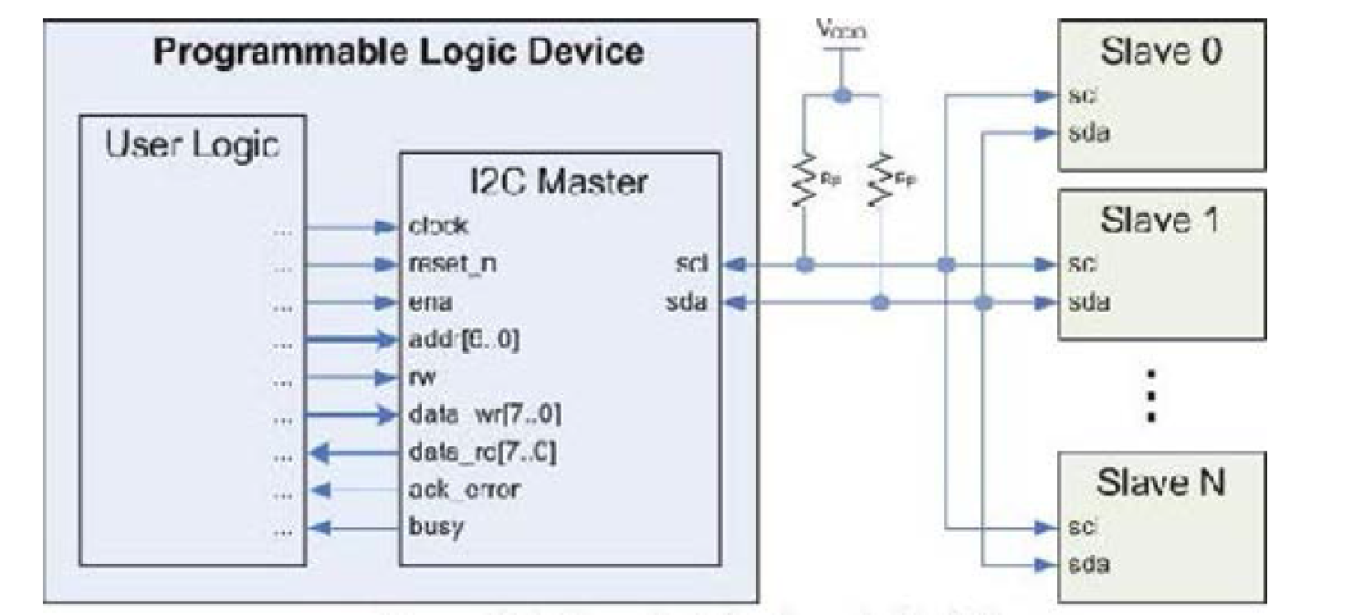

Slide 2
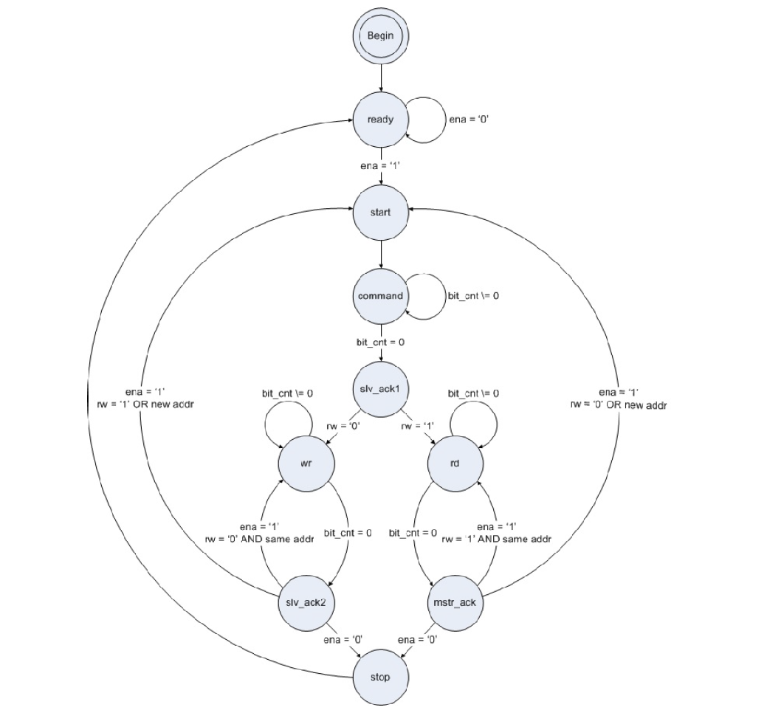

Slide 3
COMPONENT i2c_master
GENERIC(
input_clk : INTEGER := 50000000; --input clock speed from user logic in Hz
bus_clk : INTEGER := 100000); --speed the i2c bus (scl) will run at in Hz
PORT(
clk : IN STD_LOGIC; --system clock
reset : IN STD_LOGIC; --active high reset
ena : IN STD_LOGIC; --latch in command
addr : IN STD_LOGIC_VECTOR(6 DOWNTO 0); --address of target slave
rw : IN STD_LOGIC; --'0' is write, '1' is read
data_wr : IN STD_LOGIC_VECTOR(7 DOWNTO 0); --data to write to slave
busy : OUT STD_LOGIC; --indicates transaction in progress
data_rd : OUT STD_LOGIC_VECTOR(7 DOWNTO 0); --data read from slave
ack_error : BUFFER STD_LOGIC; --flag if improper acknowledge from slave
-- sda : INOUT STD_LOGIC; --serial data output of i2c bus
sda_I : IN STD_LOGIC; --serial data input of i2c bus
sda_O : OUT STD_LOGIC; --serial data output of i2c bus
sda_T : OUT STD_LOGIC; --serial data three state of i2c bus
-- scl : INOUT STD_LOGIC); --serial clock output of i2c bus
scl_I : IN STD_LOGIC; --serial data input of i2c bus
scl_O : OUT STD_LOGIC; --serial data output of i2c bus
scl_T : OUT STD_LOGIC); --serial data three state of i2c bus
END COMPONENT;

Slide 4
port
(
-- ADD USER PORTS BELOW THIS LINE ------------------
--USER ports added here
-- sda : INOUT STD_LOGIC; --serial data output of i2c bus
sda_I : IN STD_LOGIC; --serial data input of i2c bus
sda_O : OUT STD_LOGIC; --serial data output of i2c bus
sda_T : OUT STD_LOGIC; --serial data three state of i2c bus
-- scl : INOUT STD_LOGIC; --serial clock output of i2c bus
scl_I : IN STD_LOGIC; --serial data input of i2c bus
scl_O : OUT STD_LOGIC; --serial data output of i2c bus
scl_T : OUT STD_LOGIC; --serial data three state of i2c bus
PORT sda_I = "", DIR = I
PORT sda_O = "", DIR = O
PORT sda_T = "", DIR = O
PORT scl_I = "", DIR = I
PORT scl_O = "", DIR = O
PORT scl_T = "", DIR = O
#### I2C
Net i2c_scl LOC=F5;
Net i2c_sda LOC=D2;

Slide 5
|start | A7A6A5A4A3A2A1R/W | ACK | ...DATA... | ACK | stop | idle |

Slide 6
lecturaEscritura <= WFIFO2IP_Command_REG(31);
Num_bytes(0) <= WFIFO2IP_Command_REG(15);
Num_bytes(1) <= WFIFO2IP_Command_REG(14);
Num_bytes(2) <= WFIFO2IP_Command_REG(13);
Num_bytes(3) <= WFIFO2IP_Command_REG(12);
Num_bytes(4) <= WFIFO2IP_Command_REG(11);
Num_bytes(5) <= WFIFO2IP_Command_REG(10);
Num_bytes(6) <= WFIFO2IP_Command_REG(9);
Num_bytes(7) <= WFIFO2IP_Command_REG(8);
i2c_addr(0) <= WFIFO2IP_Command_REG(30);
i2c_addr(1) <= WFIFO2IP_Command_REG(29);
i2c_addr(2) <= WFIFO2IP_Command_REG(28);
i2c_addr(3) <= WFIFO2IP_Command_REG(27);
i2c_addr(4) <= WFIFO2IP_Command_REG(26);
i2c_addr(5) <= WFIFO2IP_Command_REG(25);
i2c_addr(6) <= WFIFO2IP_Command_REG(24);
IP2RFIFO_Data(31) <= i2c_data_rd(0);
IP2RFIFO_Data(30) <= i2c_data_rd(1);
IP2RFIFO_Data(29) <= i2c_data_rd(2);
IP2RFIFO_Data(28) <= i2c_data_rd(3);
IP2RFIFO_Data(27) <= i2c_data_rd(4);
IP2RFIFO_Data(26) <= i2c_data_rd(5);
IP2RFIFO_Data(25) <= i2c_data_rd(6);
IP2RFIFO_Data(24) <= i2c_data_rd(7);
I2C_mWriteToFIFO ( BASE_ADDRESS_I2C , 0, ( Xuint32 ) (( value << 8) + ( dirección << 0) + I2C_ CMD ));
I2C_mReadFromFIFO ( BASE_ADDRESS_I2C , 0)

Slide 7
i2c_data_wr_le(0 to 7) <=
WFIFO2IP_Data_REG(24 to 31) when nbyte =3
else WFIFO2IP_Data_REG(16 to 23) when nbyte =2
else WFIFO2IP_Data_REG(8 to 15) when nbyte =1
else WFIFO2IP_Data_REG(0 to 7);
-- Demos las vuelta a los bits para que sean big-endian
i2c_data_wr(0) <= i2c_data_wr_le(7);
i2c_data_wr(1) <= i2c_data_wr_le(6);
i2c_data_wr(2) <= i2c_data_wr_le(5);
i2c_data_wr(3) <= i2c_data_wr_le(4);
i2c_data_wr(4) <= i2c_data_wr_le(3);
i2c_data_wr(5) <= i2c_data_wr_le(2);
i2c_data_wr(6) <= i2c_data_wr_le(1);
i2c_data_wr(7) <= i2c_data_wr_le(0);

Slide 8
// ESCRITURA I2C 1 byte
void I2C_escritura ( Xuint32 dirección , Xuint32 dato ){
while ( I2C_mWriteFIFOFull ( BASE_ADDRESS_I2C ) == TRUE ){}
I2C_mWriteToFIFO(BASE_ADDRESS_I2C, 0, (Xuint32) ((dato << 8)) + (direccion <<0) + ESCRITURA_I2C_CMD);
}
// ESCRITURA I2C num_datos
void I2C_escritura(Xuint32 dato[], Xuint32 direccion, Xuint32 num_datos){
int i;
while (I2C_mWriteFIFOFull(BASE_ADDRESS_I2C) == TRUE){}
I2C_mWriteToFIFO(BASE_ADDRESS_I2C,0,(Xuint32)((num_datos<< 16) + (direccion <<0) + ESCRITURA_I2C_CMD));
for (i=0; i< (num_datos/4 + ((num_datos%4)!=0)); i=i+1)
{ while (I2C_mWriteFIFOFull(BASE_ADDRESS_I2C) == TRUE){}
I2C_mWriteToFIFO(BASE_ADDRESS_I2C, 0, (Xuint32) dato[i]);
}
my_delay(20);
}

Slide 9
// LECTURA I2C
Xuint32 I2C_lectura ( Xuint32 dirección ){
while ( I2C_mWriteFIFOFull ( BASE_ADDRESS_I2C ) == TRUE ){}
I2C_mWriteToFIFO ( BASE_ADDRESS_I2C , 0, ( Xuint32 ) (( dirección << 1) + LECTURA I2C CMD ));
while ( I2C_mReadFIFOEmpty ( BASE_ADDRESS_I2C ) == TRUE ){}
return I2C_mReadFromFIFO ( BASE_ADDRESS_I2C , 0);
}
#define BASE_ADDRESS_I2C 0xC3000000 /* depende del diseño
#define LECTURA_I2C_CMD 0x00000000
#define ESCRITURA_I2C_CMD 0x00000001 /* por hw se cambia el valor */
#define DIR_EXPANSOR 0x00000072 /*depende del chip particular
#define DIR_CONVERSOR 0x00000092
#define DIR_MEMORIA 0x000000A4 /*depende del chip particular

Slide 10
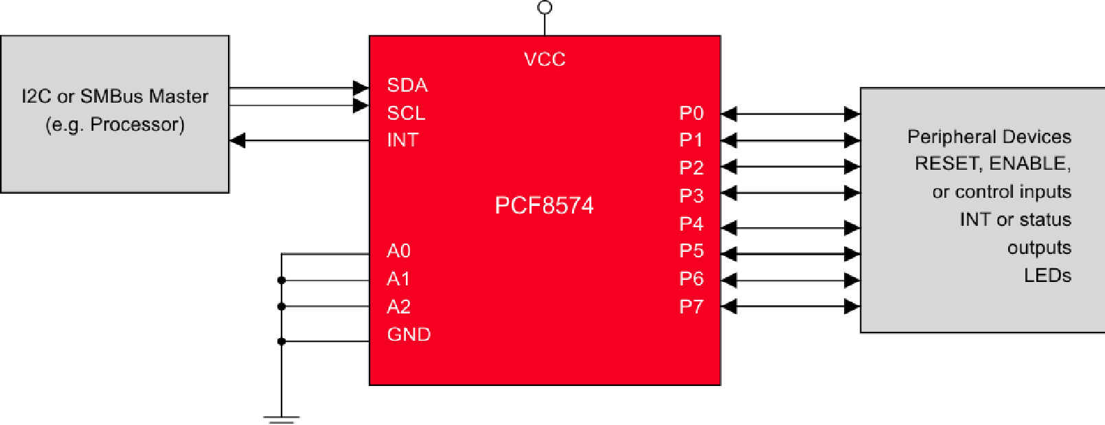
Expansor I2C PCF8574A
#define DIR_EXPANSOR 0x0000007X /*depende del chip particular

Slide 11
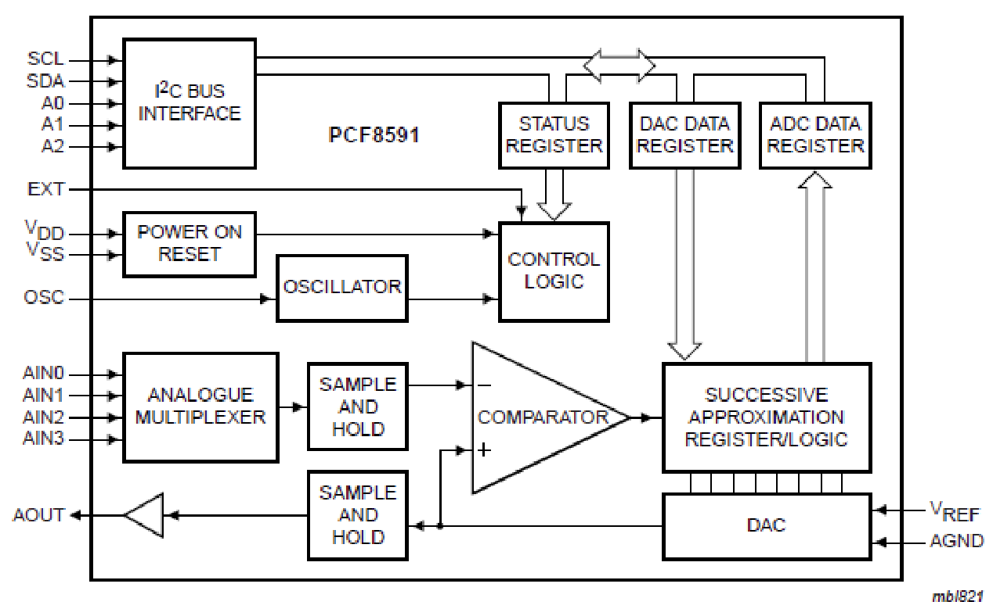
Conversor analógico/digital y digital/analógico PCF8591
#define DIR_CONVERSOR 0x0000009X

Slide 12
Antes de realizar una conversión analógica/digital, es necesario configurar adecuadamente el integrado PCF8591. Para ello, se debe escribir el valor adecuado en su registro de control. Dicho registro, de 8 bits, tiene la siguiente estructura:
| 0 | AoE | AiP1 | AiP0 | 0 | AI | Ai1 | AiO |
con el siguiente significado:
AoE (Analog output Enable): cuando vale '1', se activa la salida del conversor digital/analógico
AiP (Analog input Programming) (AiP1AiP0): programa el modo de funcionamiento de las entradas analógicas, según la tabla 15.1.
AI (Auto Increment): si vale 1, se incrementa de manera automática el canal de entrada para lecturas sucesivas
Ai (Analog input) (Ai1Ai0): selección del canal de entrada analógica.
AiP Canal 0 Canal 1 Canal 2 Canal 3 Observaciones
OO AINO AIN1 AIN2 AIN3 4 entradas analógicas simples
O1 AINO AIN3 AIN1 AIN3 AIN2 AIN3 X 3 entradas diferenciales
1O AINO AIN1 AIN2 AIN3 X 2 entradas simples y 1 diferencial
11 AINO AIN1 AIN2 AIN3 X X 2 entradas diferenciales

Slide 13
La secuencia sería la siguiente:
• Programar en el registro de control la configuración adecuada de las entradas y seleccionar el canal de entrada. Por ejemplo, para configurar las entradas como 4 entradas analógicas independientes, seleccionar el canal 0 y sin autoincremento, la secuencia que se debe enviar por el bus I2C es la siguiente:
| start | 1001 0000 | ACK | 0000 0000 | ACK | stop | idle |
• Leer el valor de la conversión:
| start | 1001 0001 | ACK | VVVV VVVV | ACK | stop | idle |

